Slide 1
Guided by: Mr Bose Student: Venkatesh D.s Academic:2019-2020
Welcome
Case study-2

Slide 2
“Analysing the source of dissatisfaction among AFL fans” .

Slide 3
Introduction….
The AFL Grand Final is an annual Australian rules football match, traditionally held on the final Saturday in September at the Melbourne Cricket Ground in Melbourne, Australia, to determine the Australian Football League (AFL) premiers for that year.
The AFL Commission received many complaints from fan in 2018 so Deputy conducted a survey of 200 random fans in order to determine the source of dissatisfaction among the AFL fans.

Slide 4
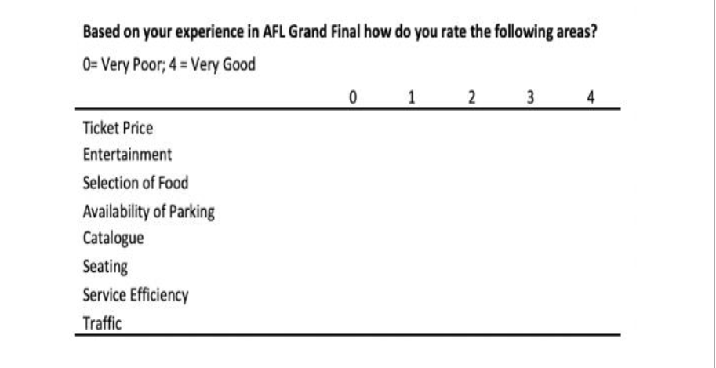
Survey Form ….

Slide 5
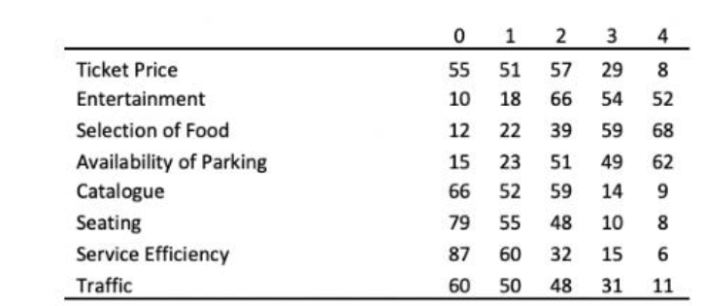
Complaints Received by the AFL fans..

Slide 6

Time to Analyse the Data…..

Slide 7
Since the frequency in the given data is not same ,to calculate the average use the concept of “ weighted average”.
Calculate the cumulative frequency and cumulative percentage,to determine the priority of the cause.
Draw the Pareto chart and Fish bone diagram to represent graphically .

Slide 8
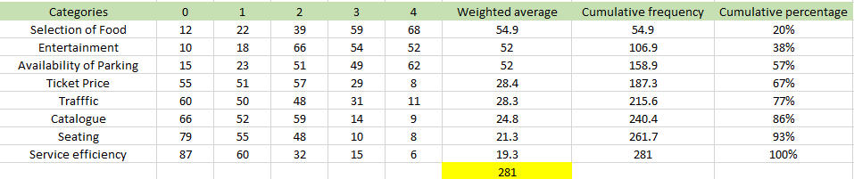
Calculations….

Slide 9
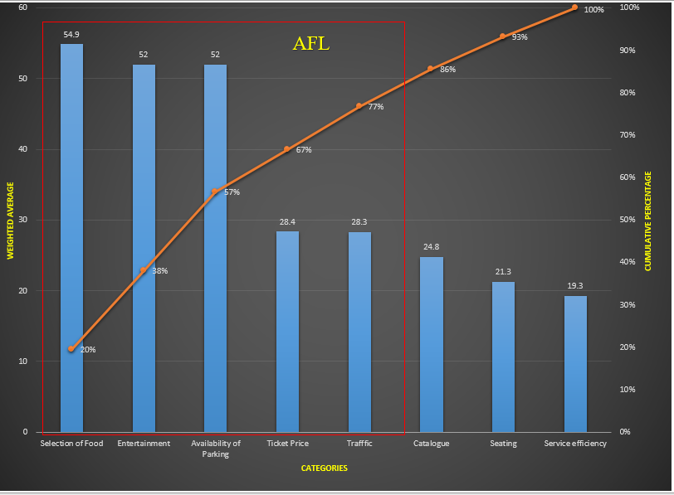
Pareto Chart..

Slide 10
From the above chart we can conclude..
Categories like Selection of food, Entertainment, Availability of parking space, Ticket price and Traffic corresponds to the 80% of data which leads to dissatisfaction among the AFL fans.
These categories have to resolved in order to provide satisfaction to the AFL fans.

Slide 11
Determine the cause and effect by using Fishbone diagram .
Selection of food
Combination of food items are less.
Quantity and Quality of food was not sufficient
System of food supply was poor
Ticket price
Ticket price was quite high
Discount is not provided
Extra facilities like gift coupons are not provided

Slide 12
To be continued….
Entertainment
Favourite team lost the game.
Cheering up in the ground was not sufficient
Disc jockey was not so good
Availability of parking
Parking facility was poor due to less available space.
Parking sign boards was not clear
Parking staff was not trained properly

Slide 13
To be continued….
Traffic
Que system is not maintained properly.
Crowed were not cleared properly.
Vehicle passing lane is not good.

Slide 14
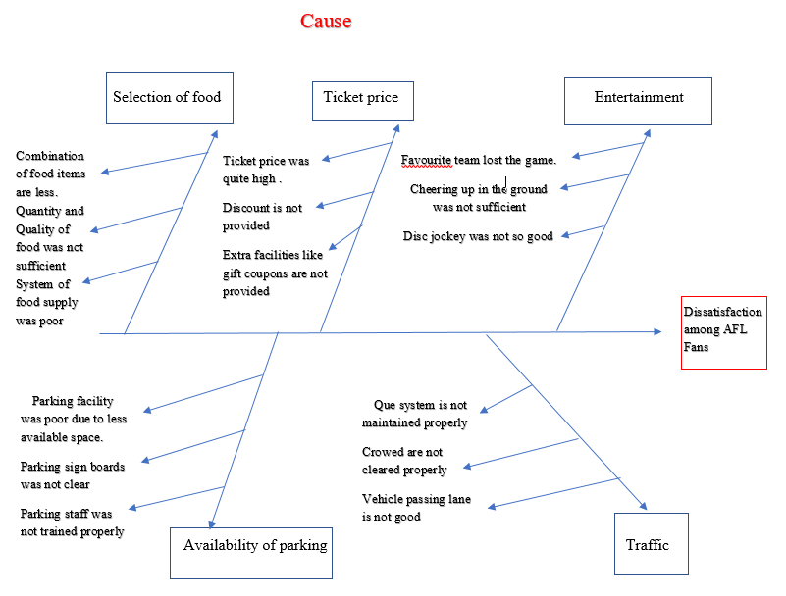
Fishbone Diagram……

Slide 15

Thank you…

